Slide 1
Academic Success and Integrity at SU
Notes:
This presentation is designed to support new-to-campus domestic and international students in their academic transition to their first semester on campus at SU. The seminar attempts to make visible and meaningful elements of academic culture that affect students’ academic success but are often not conveyed explicitly: the need to use research-based active learning strategies in response to the demands of coursework at a research university like SU; and, the heightened expectations for academic integrity that result from the intersection of university research and teaching.
This presentation is intended to provide a template that instructors can modify to suit their students, courses and goals. The presentation focuses on undergraduate students who are new to SU. We encourage you to make it relevant to your students and courses by adding and subtracting material to suit your needs.
The presentation is designed to help new SU students achieve three learning objectives:
Recognize that their academic success depends upon learning the SU academic culture rather than assuming they understand it already, AND identify one strategy they will use to do this;
Identify two research-based learning strategies they will use inside and outside the classroom, including one strategy that involves using the syllabus; and,
Demonstrate basic understanding of the University’s academic integrity expectations.

Slide 2
Academic Success and Integrity
GET TO KNOW THE CULTURE
USE RESEARCH-BASED STUDY STRATEGIES
UNDERSTAND & UPHOLD ACADEMIC INTEGRITY STANDARDS
THREE KEY Elements of SU Academic Culture
Notes:
Most new students – whether they come to here from Syracuse or from Beijing - find that some elements of the academic expectations here at SU are new to them. This presentation is designed to make some key expectations explicit.
You may want to start by telling students about your own experience coming to SU and learning the culture here – and about your teaching and research.

Slide 3
Academic Success and Integrity
GET TO KNOW THE CULTURE
USE RESEARCH-BASED STUDY STRATEGIES
UNDERSTAND & UPHOLD ACADEMIC INTEGRITY STANDARDS
OBSERVE, ASK, LEARN!
Don’t assume you know.
Notes:
One of the most important things new students can do to succeed academically is to observe, learn, and ask questions. When becoming a member of a new community/culture it is important not to assume that you know everything there is to know. Stress the value of asking questions of their professors and participating in class discussion. You may want to give students opportunities to do this during this presentation.

Slide 4
Academic Success and Integrity
USE RESEARCH-BASED STUDY STRATEGIES
UNDERSTAND & UPHOLD ACADEMIC INTEGRITY STANDARDS
GET TO KNOW THE CULTURE
A new friend invites you
to her family’s home for dinner.
What do you need to know?
How do you find out?
Notes:
Thinking about how they have adapted to different families, households or cultures in the past can help students think about how to adapt to the new academic culture of SU.

Slide 5
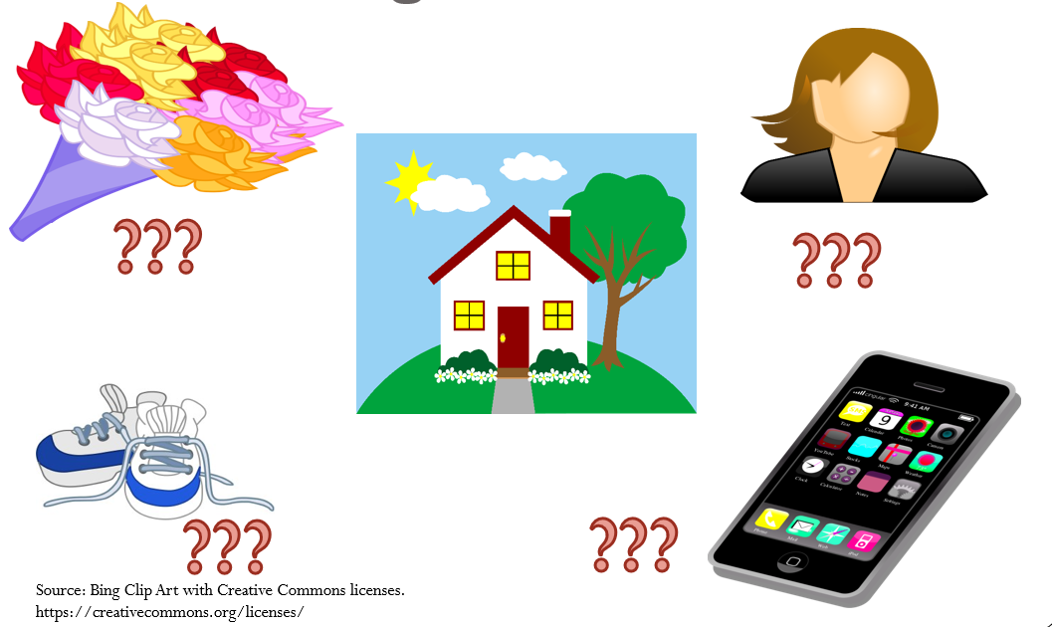
Secrets for SUccess
Notes:
Ask the students to think of a time when they a) traveled outside their own country, b) visited a new region of their own country, or, c) went for the first time to the family home of a new friend.
Prompt students with an illustration: Recount your own experience with a cultural difference that surprised you when you traveled or visited a new friend’s home. The difference can be small (e.g. whether to take off shoes, bring a gift, or put away cell phones) but should be something that mattered in the new culture.
Have students share some of their responses aloud and discuss them. Reinforce the idea that coming to SU means joining a new community with its own set of academic expectations. Understanding those expectations helps newcomers become part of the SU community. Point out that this is true for new faculty and staff as well as for new students.

Slide 6

New Home = New Rules & Expectations
USE RESEARCH-BASED STUDY STRATEGIES
UNDERSTAND & UPHOLD ACADEMIC INTEGRITY STANDARDS
GET TO KNOW THE CULTURE
https://collage.syr.edu
Notes:
Ask students what they already notice as being different between SU and their high school (larger classes, dorm life, more diversity, more freedom, etc.)
Use this as a lead into a discussion on the academic culture at SU.
If your course includes returning or transfer students, you can broaden this discussion by encouraging students to compare SU to a previous college or university they attended or to reflect upon changing norms at SU.

Slide 7
New Home = New Rules & Expectations
USE RESEARCH-BASED STUDY STRATEGIES
UNDERSTAND & UPHOLD ACADEMIC INTEGRITY STANDARDS
GET TO KNOW THE CULTURE
SU is a “student-focused
research university”
https://www.syracuse.edu/about/vision-mission/
What does this mean?
How does this affect you?
Notes:
Ask students what they already notice as being different between SU and their high school or previous institution (larger classes, dorm life, more diversity, more freedom, etc.)
Use this as a lead into a discussion on the academic culture at SU.

Slide 8
Academic Success and Integrity
USE RESEARCH-BASED STUDY STRATEGIES
UNDERSTAND & UPHOLD ACADEMIC INTEGRITY STANDARDS
GET TO KNOW THE CULTURE
Don’t assume…ASK!
Successful professionals
achieved their success by
learning when & how to
ask for help
Notes:
Talk with students about how asking questions and actively learning new expectations contributed to your career, or discuss the importance of asking questions in your class.

Slide 9
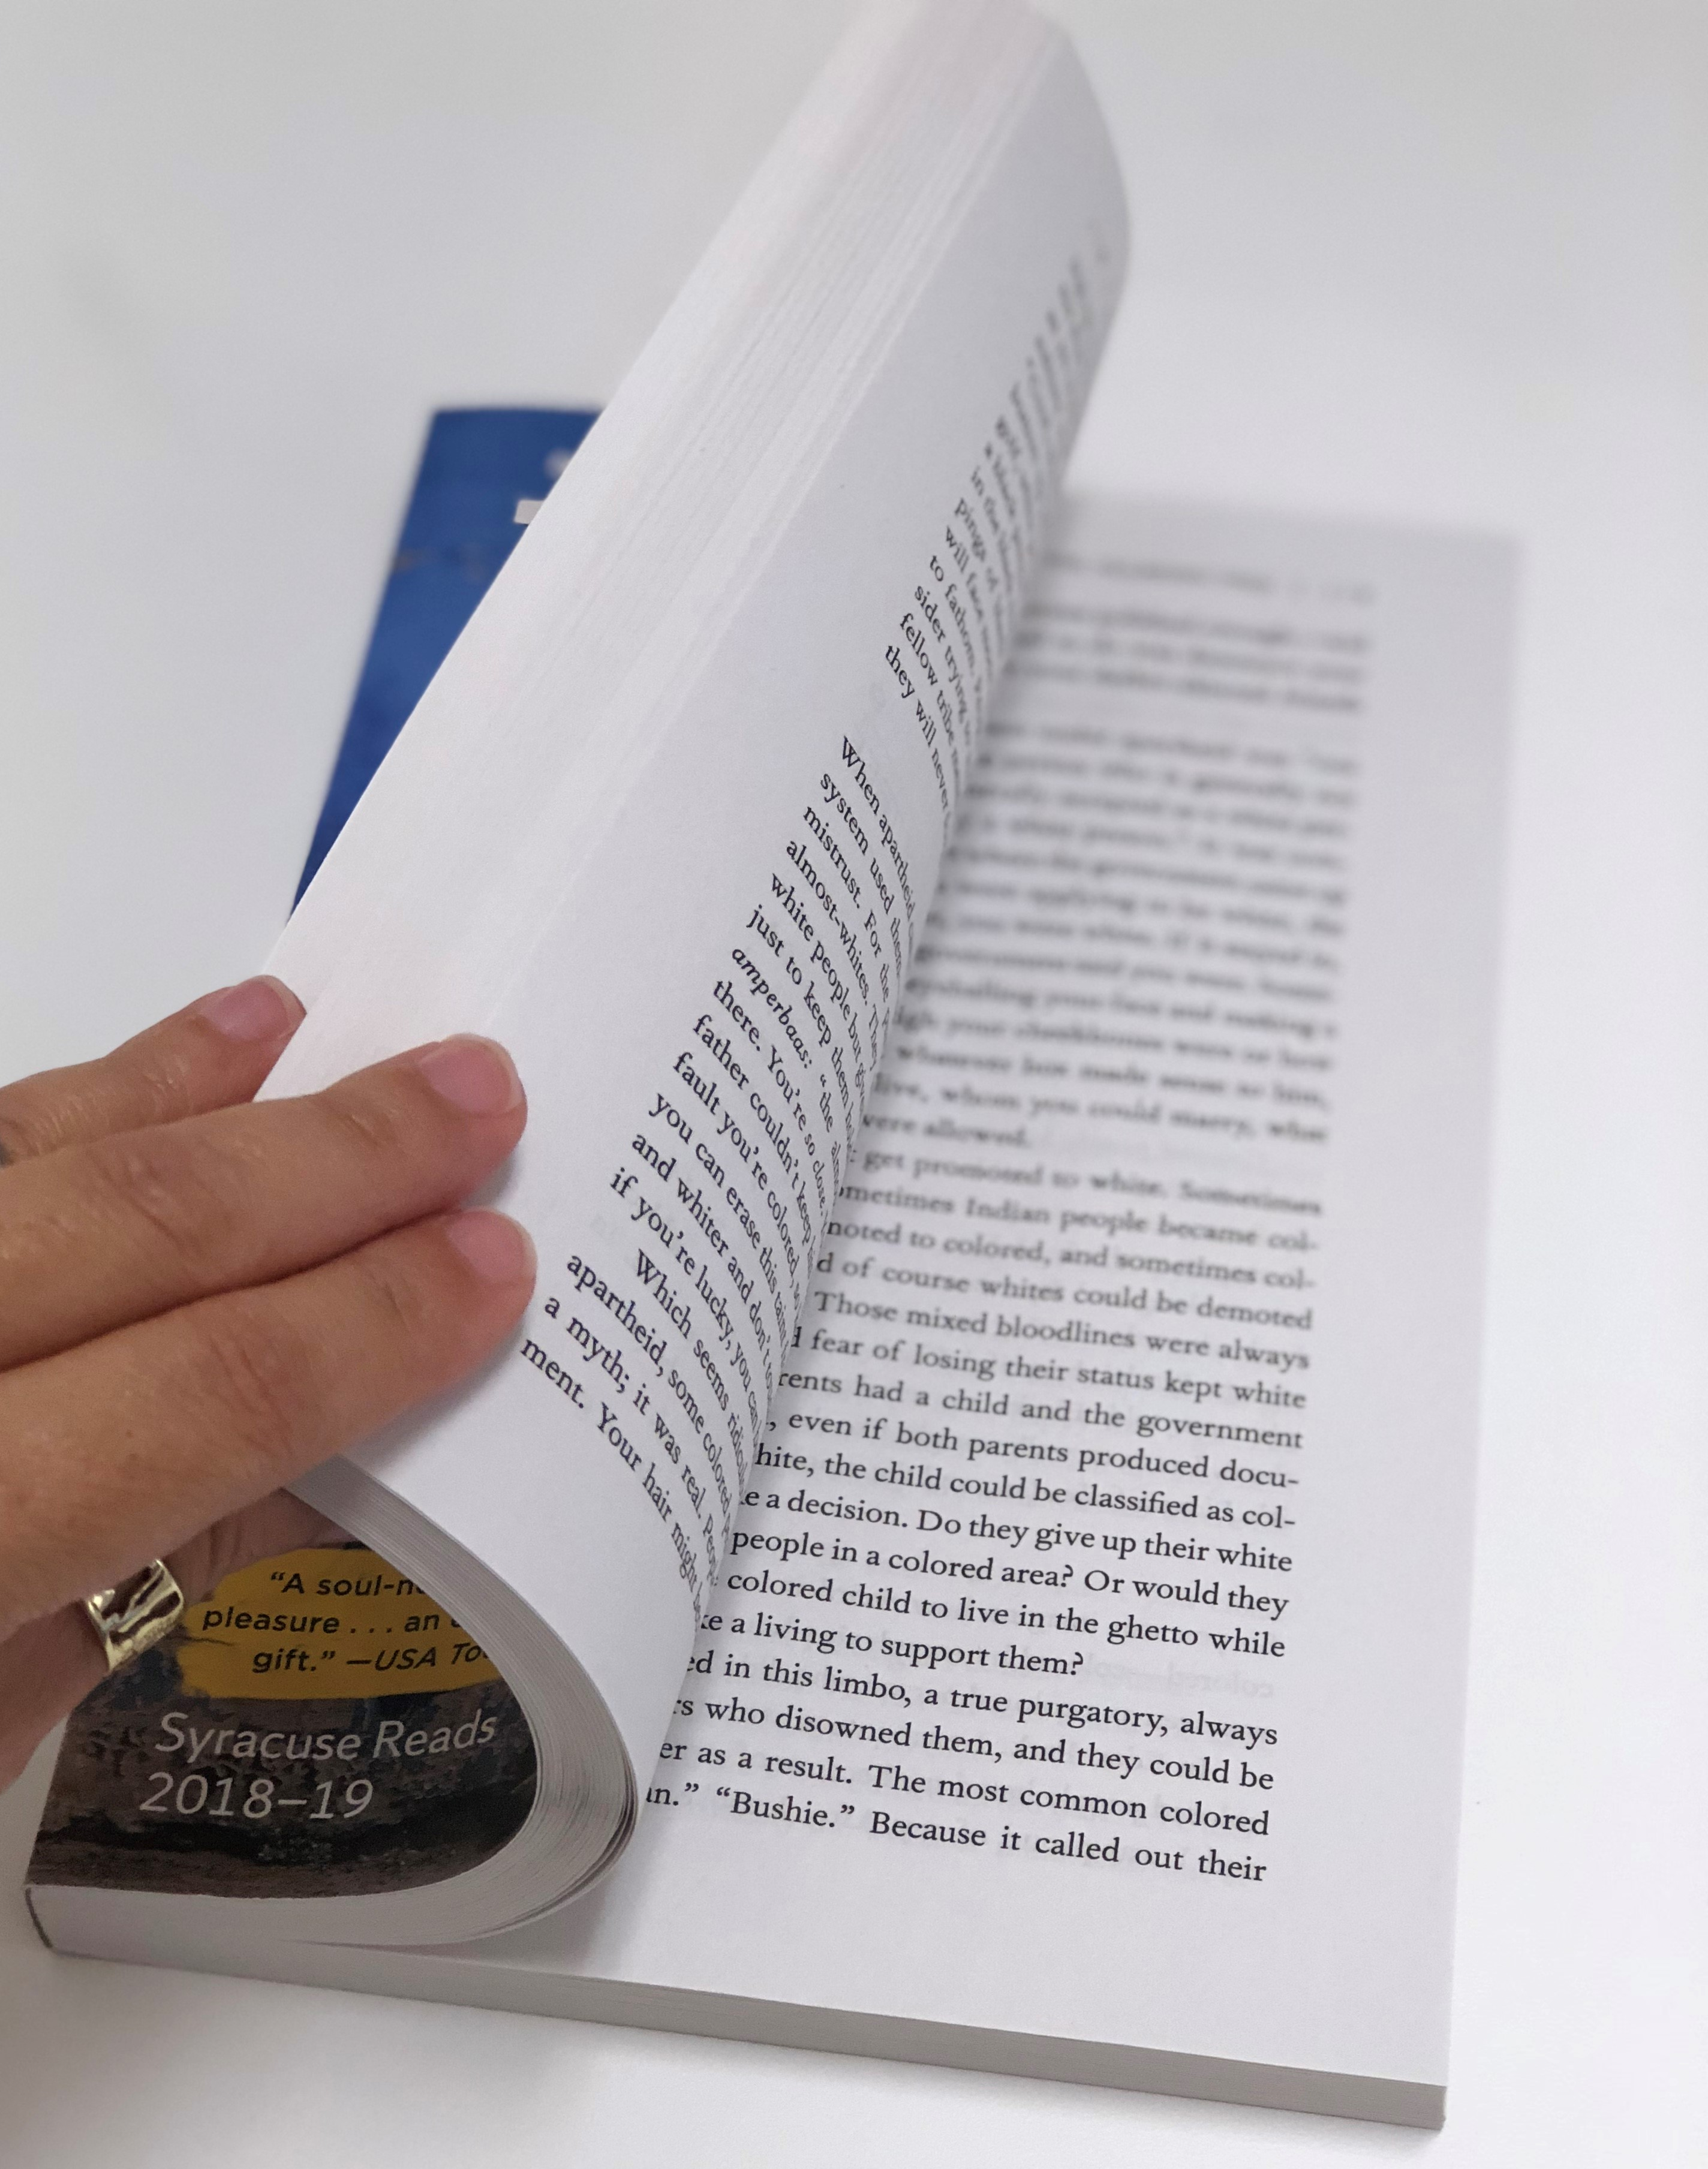



Academic Success and Integrity
explain it
GET TO KNOW THE CULTURE
USE RESEARCH-BASED STUDY STRATEGIES
UNDERSTAND & UPHOLD ACADEMIC INTEGRITY STANDARDS
draw it
Closing a book-picture taken by Kennia Delafe/ August 23-2018
Retrieved from Pickit Free Images #12921422 Accessed on 8/23/2018
solve it
think about it
Retrieved from Pickit Free Images #9629002 Accessed on 8/23/2018
Retrieved from Pickit Free Images #6454124 Accessed on 8/23/2018
Notes:
Explain that an important part of the academic culture here at Syracuse is the central role students play in your own learning. In many high schools (and some colleges), listening in class, taking notes and reading the textbook are all students need to do well. Here, to do well academically, especially in upper level courses, you will be need to take a more active role in the classroom and in the studying you do outside the classroom.
This is true because you will spend less time in class than you did in high school and because the material will be covered at a much faster pace. This means that you will need to spend more time studying on your own.
Most first-year students – regardless of what academic experiences they had before coming to SU or where they come from - find they need to make changes in how they study in order to do well here.
Studies show that college students rely heavily on ineffective study strategies like re-reading, highlighting, or reviewing a math problem someone else has solved. Ask students, what do these ineffective study strategies have in common? Take a minute to think about this: What is similar about re-reading, highlighting and reviewing a math problem someone else has solved? It’s fine if you aren’t sure how to answer this question. But it’s important to come up with your best guess. Often in smaller classes here at SU faculty will expect students to answer questions like this one during class discussion. Faculty don’t expect you to always have the right answer. For some questions, there is no single correct answer. What’s important is that you are an active participant in class and that you speak during question and answer sessions.
Explain that these three strategies are largely passive. That’s the key reason that re-reading, highlighting and reviewing are poor study strategies.
Decades of research shows that lasting learning requires active effort that often feels challenging. What you just did now – making a reasoned guess at the answer to a question before being told the answer – is an example of an active and highly effective study strategy. Making reasoned guesses about subjects you haven’t been taught may sound strange, but research in cognitive psychology shows it is highly effective – even when you guess wrong. That’s because the guesswork you do forces you to relate the new material you’re working to learn to existing information you already know. Making reasoned guesses is just one example of a powerful active study strategy that can feel hard but, in the long run, is more efficient and effective in helping you master new material than passive strategies like highlighting.

Slide 10
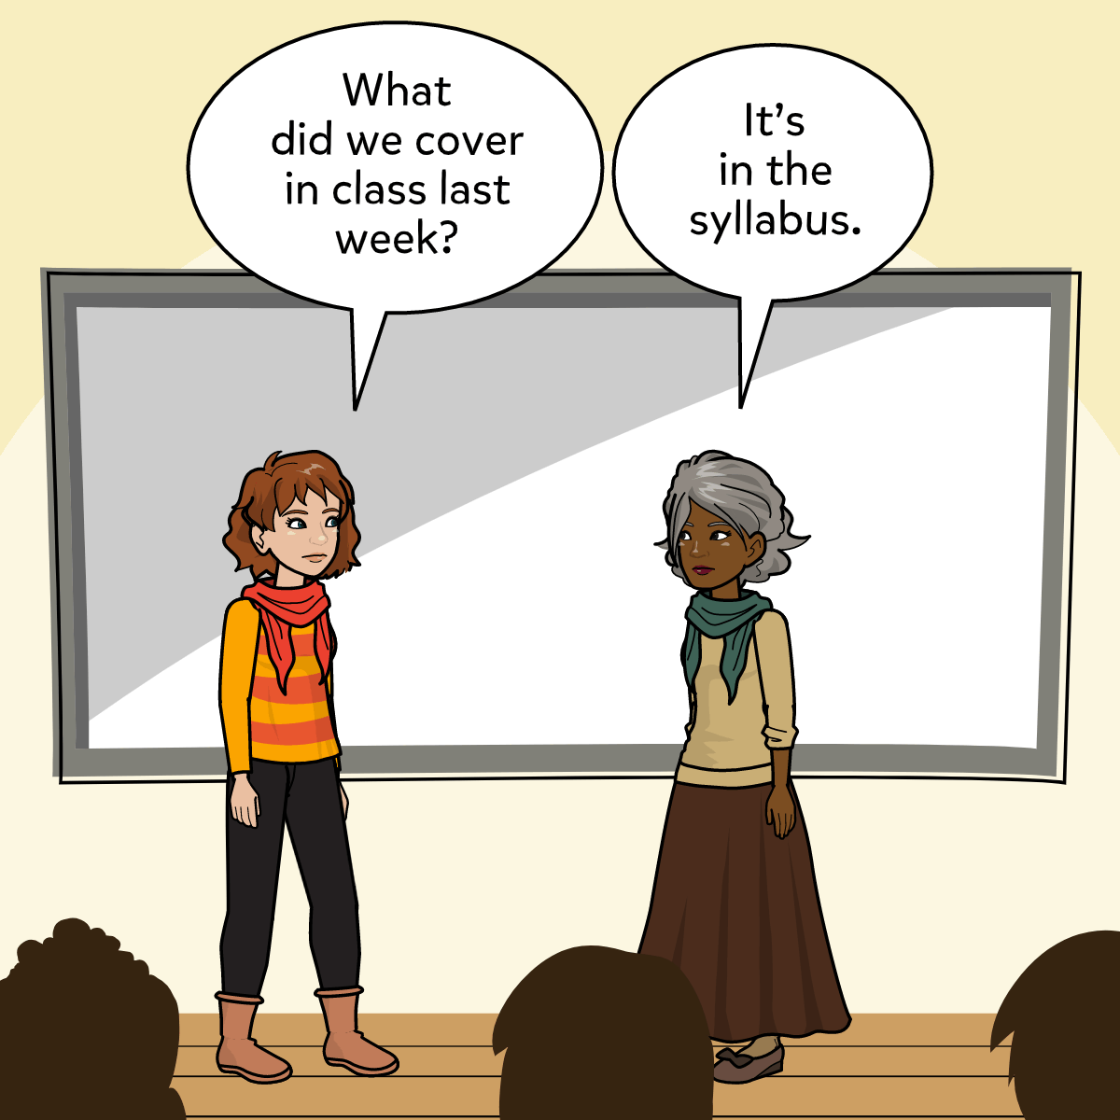
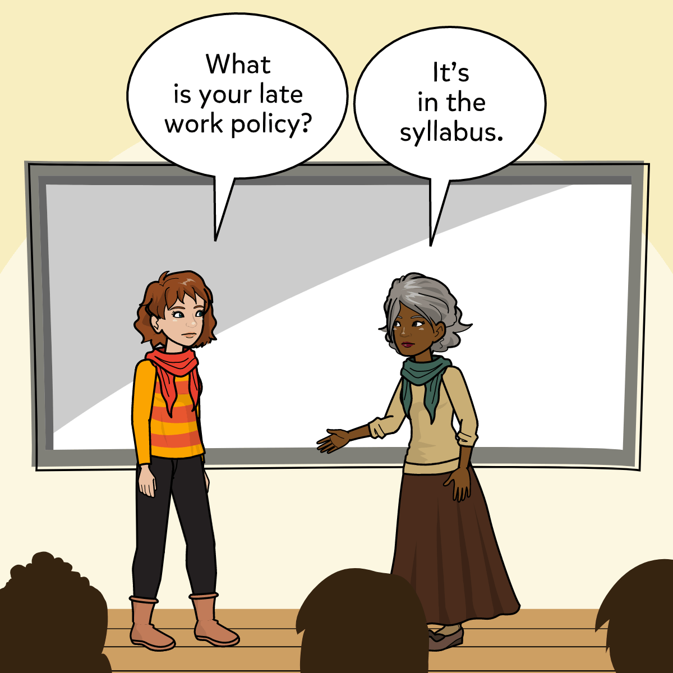
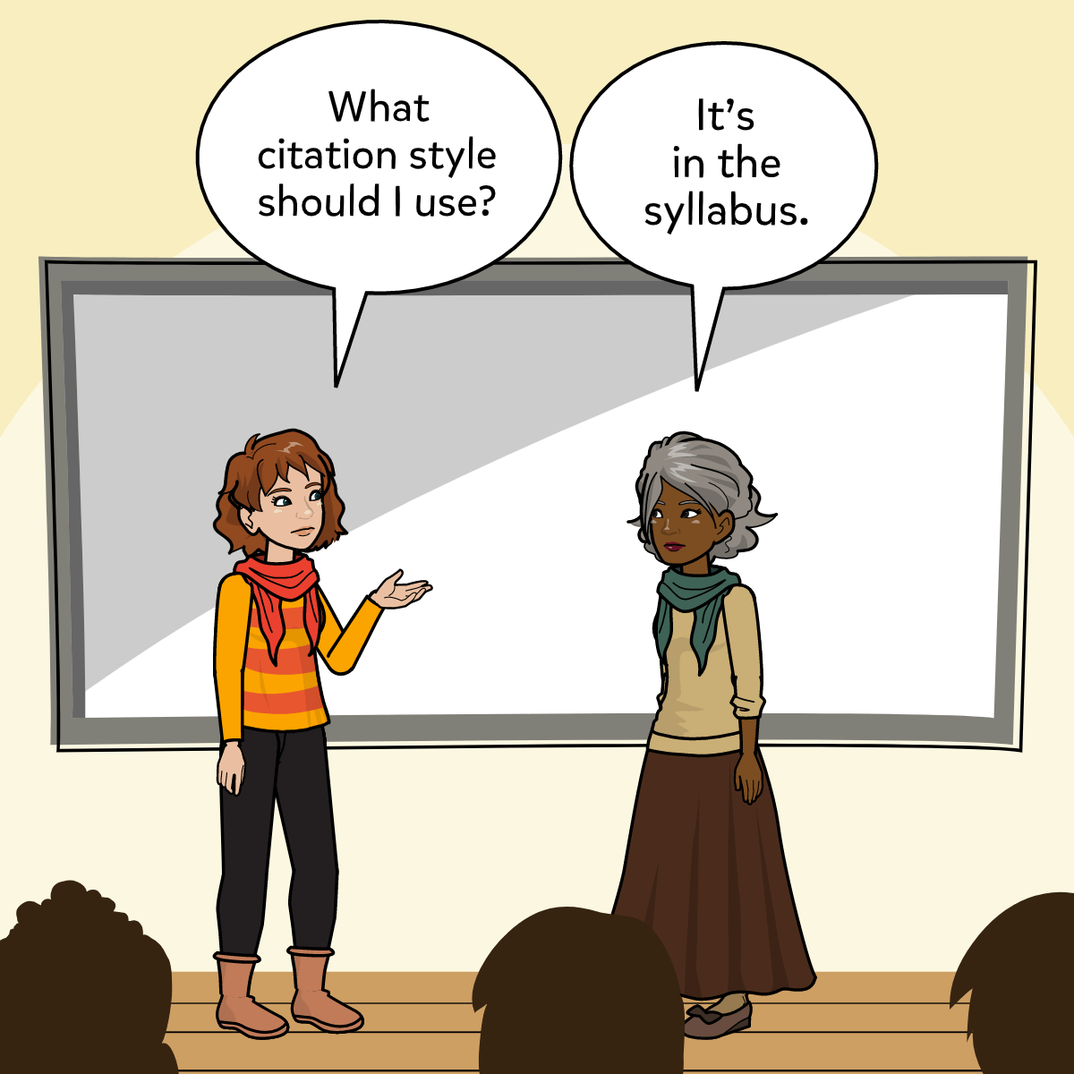
It’s in the Syllabus
Made with Pixton.com
Notes:
Students may not be accustomed to having course syllabi or to using them regularly throughout the semester. Explaining how and when you expect students to use your syllabus can help them understand it as a roadmap to your course.

Slide 11
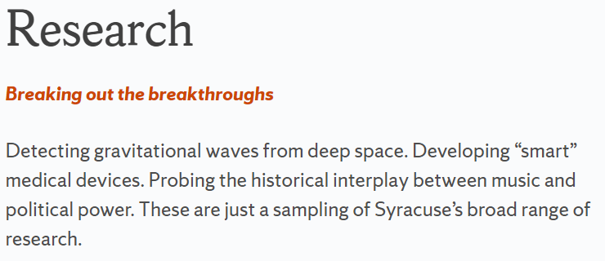

Academic Integrity
GET TO KNOW THE CULTURE
USE RESEARCH-BASED STUDY STRATEGIES
UNDERSTAND & UPHOLD ACADEMIC INTEGRITY STANDARDS
https://www.syracuse.edu/academics/research/
Notes:
At a research university like SU, many faculty view students’ academic work as part of the university’s larger research agenda.
That is, professors view research and teaching as closely connected. The academic work you produce in your classes is expected to follow the same principles that your professors follow in their own research. This means that students are held to the same academic integrity standards faculty follow.
This is another important expectation that isn’t always clear to students: Although most students do not plan to become college professors, while here you are expected to uphold the same academic integrity standards faculty follow in the academic research they publish.

Slide 12

Academic Integrity
GET TO KNOW THE CULTURE
USE RESEARCH-BASED STUDY STRATEGIES
UNDERSTAND & UPHOLD ACADEMIC INTEGRITY STANDARDS
Family Tree
Retrieved from https://app.pickit.com/#/market/search/results/tree/1/photo/1uao6gkzbg3wctadqk82cb3c1. Accessed on 7/29/2019.
Notes:
Few students plan to cheat so many tune out when instructors discuss academic integrity. Instructors can reduce this risk by emphasizing that meeting academic integrity expectations requires more than being a good person. Students need to know the four sets of university-wide expectations at SU and additional expectations specific to the courses they are taking.
It can be helpful to explain that faculty at a large research institution like SU tend to hold students to the same standards that apply to them when they publish in academic journals.
In published academic research, the origin of the ideas – and the people who came up with those ideas – matter as much as the ideas themselves. That’s why research published in academic journals includes an entire section or chapter called the “literature review.” The literature review describes earlier research that the author used in developing her or his research. This is very different from many other professional settings (e.g. intra-office memoranda, political speech writing, journalism published by “editors”) in which ideas themselves matter far more than the identify of the author of those ideas.
An academic literature review resembles a “family tree” for academic research. A family tree traces all the generations of a family. A literature review traces all the previous research and researchers whose work made the new research possible. So, just like you wouldn’t leave an elderly relative off your family tree because you have not met her, you should never leave any outside source you use out of your paper, in-class presentation, video or other work you produce for your classes.
Having research cited and recognized by other researchers is important for faculty members at research universities like SU. Having their researched cited by others is prestigious and important for their careers. So is being honest in all their academic work.
This helps explain why faculty care so much about their students’ academic integrity. They treat undergraduate students as members of the SU academic research community and expect students to live up to academic integrity expectations when they write papers and take exams. Penalties for violating academic integrity expectations can be serious, including course failure and, in some instances, suspension or expulsion from Syracuse University.
In writing a paper, making an oral presentation or creating visual work products, students are expected to provide references for all the sources they use. That’s true whether you find those sources on a website, use a quotation from a textbooks, or get help from a friend or roommate. Don’t leave any source out, just as you wouldn’t leave a family member off your family tree. The goal is to make sure readers – and viewers and listeners – realize that you’re using other people’s ideas. That’s what citation is all about, not the particular citation format you use but making it clear to your audience that you are drawing upon someone else’s ideas and giving your audience enough information that they could look up those ideas.

Slide 13

Academic Integrity Expectations
GET TO KNOW THE CULTURE
USE RESEARCH-BASED STUDY STRATEGIES
UNDERSTAND & UPHOLD ACADEMIC INTEGRITY STANDARDS
Four Broad Categories.
Neither the categories nor the examples of violations are exhaustive.
Any action that improperly influences the evaluation of a student’s academic work, gives one student unfair academic advantage over another, or encourages the violation of academic integrity by others constitutes a violation of this policy.
Retrieved from https://app.pickit.com/#/market/featured-collections/photos/1/photo/yp4gc70sjg0hi59ro10hd5bf1.
Accessed 7/30/2019.
Notes:
Syracuse University classifies academic integrity expectations in four broad categories designed for educational purposes.
Neither the categories themselves nor the examples of violations are exhaustive.
Any action that improperly influences the evaluation of a student’s academic work, gives one student unfair academic advantage over another, or encourages the violation of academic integrity by others constitutes a violation of this policy.

Slide 14

Academic Integrity Expectations
GET TO KNOW THE CULTURE
USE RESEARCH-BASED STUDY STRATEGIES
UNDERSTAND & UPHOLD ACADEMIC INTEGRITY STANDARDS
Syracuse University sets general guidelines for university-wide academic integrity standards.
In recognition that learning objectives vary across courses, the University also strongly encourages instructors to establish course-specific academic integrity expectations, particularly with regard to what forms of collaboration are allowed and prohibited.
It is the responsibility of all instructors to communicate course-specific academic integrity expectations to students.
Retrieved from https://app.pickit.com/#/market/featured-collections/photos/1/photo/xqksypdyl3qd9kex2enh2h-02.
Accessed 7/30/2019.
Notes:
Syracuse University sets general guidelines for university-wide academic integrity standards.
In recognition that learning objectives vary across courses, the University also strongly encourages instructors to establish course-specific academic integrity expectations, particularly with regard to what forms of collaboration are allowed and prohibited.
It is the responsibility of all instructors to communicate course-specific academic integrity expectations to students.

Slide 15

Academic Integrity Expectations
GET TO KNOW THE CULTURE
USE RESEARCH-BASED STUDY STRATEGIES
UNDERSTAND & UPHOLD ACADEMIC INTEGRITY STANDARDS
Any student who is uncertain whether an action they are considering would violate academic integrity expectations is responsible for asking the instructor or consulting the Center for Learning and Student Success (CLASS) beforehand.
Retrieved from https://app.pickit.com/#/market/featured-collections/photos/2/photo/1g9_f5266irgole5qxrh21-r0. Accessed 7/30/2019.
Notes:
Any student who is uncertain whether an action they are considering would violate academic integrity expectations is responsible for asking the instructor or consulting the Center for Learning and Student Success (CLASS) beforehand.

Slide 16
Academic Integrity Expectations
GET TO KNOW THE CULTURE
USE RESEARCH-BASED STUDY STRATEGIES
UNDERSTAND & UPHOLD ACADEMIC INTEGRITY STANDARDS
Case Study #1
Chris is taking an introductory literature class. Their instructor assigns the students to write a book review describing a novel they have read. To gather ideas for the book review, Chris goes online and finds three book reviews discussing the recently published novel. Chris agrees with the views expressed by two of the reviewers and decides to describe their opinions in the book review. Because Chris is drawing on the reviewers’ opinions – not facts – and because Chris agrees with those opinions, Chris does not include references for the two reviews.
  Has Chris violated AI Policy? Why or why not?
Notes:
We encourage you to use the case studies in this presentation as an opportunity to engage students in discussion of academic integrity standards.
Having students read through a case study and find the section of the Academic Integrity Policy relevant to that case study can be an effective way to organize discussion.
The title of this slide links to the expectations and policy page of the CLASS website where students can view the Academic Integrity Policy: https://class.syr.edu/academic-integrity/policy/.

Slide 17
Expectation 1: Credit Your Sources
GET TO KNOW THE CULTURE
USE RESEARCH-BASED STUDY STRATEGIES
UNDERSTAND & UPHOLD ACADEMIC INTEGRITY STANDARDS
WHO
&
WHAT
do students need to acknowledge?
WHAT constitutes a source?
WHAT
does proper citation require?
WHAT
types of sources must be credited?
Notes:
Students must acknowledge their use of other peoples’ ideas, information, language, images and other original scholarly and creative output when they incorporate these materials – directly or indirectly – into their own academic work.
Sources include scholars and published research, as well as fellow students and other individuals who must be credited whenever their ideas are incorporated into another student’s work.
At a minimum, proper citation requires using quotation marks to identify others’ verbatim language and providing in-text citations and bibliographic references to identify sources of direct quotation, paraphrasing, summarizing, and the borrowing of ideas and images.
Sources must be credited regardless of whether those sources are published or copyrighted and regardless of whether they exist in print or online.
Sources must be credited not only in written work, but also in oral and visual presentations, computer code, and other academic assignments, including any draft assignment submitted to an instructor whether or not the draft will be graded.
Therefore, Chris has violated AI Policy because acknowledging and citing sources is required any time you draw upon other people’s ideas or creative work in your academic work. Whether the material you incorporate is fact or opinion and whether or not you agree with the person whose ideas or work you use, you must site them. The key is 1) making it clear to readers (or listeners or viewers if your work is oral or visual) that you drew upon someone else’s ideas, research or creative work and 2) providing enough information in the citation that a reader, listener or viewer can use that information to track down the source and review it for themself.
Drawing upon other people’s ideas and research is a central part of academic research. Students sometimes think the goal should be to avoid the use of outside sources and the need for citation because we talk about “original” contributions to research. It may be helpful to explain that researchers always acknowledge work that came before their own and made their work possible, such as experiments or theories they drew upon and that made it possible for them to develop their own contributions.

Slide 18
Academic Integrity Expectations
GET TO KNOW THE CULTURE
USE RESEARCH-BASED STUDY STRATEGIES
UNDERSTAND & UPHOLD ACADEMIC INTEGRITY STANDARDS
Case Study #2
Four students who live in the same learning community are taking the same biology class. The large class breaks into smaller groups for labs, some held on Mondays, others on Wednesdays. Sonia, whose lab meets on Monday, lends Rob a copy of her lab report so that he will be prepared for his lab on Wednesday.
  Has Rob violated AI Policy? Has Sonia? Why or why not?
Notes:
We encourage you to use the case studies in this presentation as an opportunity to engage students in discussion of academic integrity standards.
Having students read through a case study and find the section of the Academic Integrity Policy relevant to that case study can be an effective way to organize discussion.
The title of this slide links to the expectations and policy page of the CLASS website where students can view the Academic Integrity Policy: https://class.syr.edu/academic-integrity/policy/.

Slide 19

Expectation 2: Do Your Own Work
GET TO KNOW THE CULTURE
USE RESEARCH-BASED STUDY STRATEGIES
UNDERSTAND & UPHOLD ACADEMIC INTEGRITY STANDARDS
Any work submitted by a student must be their own unless stated otherwise by instructor.
  This applies to:
    Homework as well as other written, oral and creative assignments.
    Examinations and quizzes, including in-class, online and take-home.
Adhere to instructor’s policies on collaboration or editing.
Students are responsible for asking questions in advance if they are uncertain about expectations.
Retrieved from https://app.pickit.com/#/market/featured-collections/photos/2/photo/sb_h3c-t_n1sqtgxrlkdw0cs2. Accessed 7/30/2019.
Notes:
Any work a student submits for a course must be solely their own unless an instructor gives explicit instructions allowing collaboration or editing.
This applies to homework as well as to other written, oral and creative assignments.
When collaboration or editing by someone other than the student is permitted – or required – it is each student’s responsibility to adhere to any limits on editing or collaboration set by the instructor.
Examinations and quizzes of all kinds, including online and take-home as well as in-class exams, must reflect only the work of the submitting student without assistance from other people or resources such as texts, websites or notes unless the instructor has specifically allowed their use.
Instructors who allow collaboration or the use of written, online or other resources during an exam or quiz are responsible for clearly communicating their expectations.
Students are responsible for asking questions in advance if they are uncertain about these expectations.
Thus, whether or not Sonia and Rob have violated Academic Integrity Policy depends on the rules around collaboration in their course. In general, however, it is best to help another student by talking to them about assigned work. Giving someone else your completed work is unwise. If your friend turns the work in as their own or uses pieces of it without attributing the work to you, both of you may be in violation of course expectations and policy.

Slide 20
Expectation 2: Do Your Own Work
GET TO KNOW THE CULTURE
USE RESEARCH-BASED STUDY STRATEGIES
UNDERSTAND & UPHOLD ACADEMIC INTEGRITY STANDARDS
WHAT
constitutes a violation during a quiz or exam?
Having prohibited resources on hand or within easy reach. Items include but are not limited to:
  Notes
  Cell phones
  Electronic devices
Dishonestly obtaining and/or sharing contents of a quiz or exam
OR
Providing unauthorized assistance to another student taking a quiz or exam
Notes:
Having notes, cell phones, electronic devices or other prohibited resources available on one’s person or within easy reach during an exam constitutes a violation whether or not these items are used in completing the quiz or exam.
Emphasize the fact that students CANNOT have prohibited resources in sight during an exam. Tell them it’s best not to bring these things to an exam, but if they do, they need to hide them in their book bag or have the exam proctor hang onto them for the duration of the exam.
Dishonestly obtaining and/or sharing the contents of a quiz or exam not provided by the course instructor constitutes a violation as does providing unauthorized assistance of any form to another student taking a quiz or exam.

Slide 21
Expectation 2: Do Your Own Work
GET TO KNOW THE CULTURE
USE RESEARCH-BASED STUDY STRATEGIES
UNDERSTAND & UPHOLD ACADEMIC INTEGRITY STANDARDS
WHY is recycling old work a violation?
Submitting work completed previously for another course or purpose deprives students of the opportunity to learn from current assignment
  Students seeking to turn in the same work in more than one course or to turn in work previously completed for another purpose or submitted to another organization or institution (including high school) must obtain written approval from ALL relevant University instructors before submitting the work
Notes:
Submitting work completed previously for another course or purpose constitutes a violation of this policy as such double use of material deprives students of the opportunity to learn from the current assignment.
Students seeking to turn in the same work in more than one course or to turn in work they have previously completed for another purpose or submitted to another organization or institution, including a high school, must obtain written approval from all relevant University instructors before submitting the work.
This requirement applies to all course work regardless of format, including art, computer code, oral reports, and other course output in addition to written assignments.
Many instructors will allow students to expand the scope of an assignment so as to legitimately submit it for two courses or requirements.
Students pursuing capstone projects eligible for submission to two programs, such as to Honors and to the student’s major, must ascertain that both programs or courses will accept the same or substantially the same work and obtain written permission in advance from the relevant instructors or program directors.

Slide 22
Expectation 3: Communicate Honestly
GET TO KNOW THE CULTURE
USE RESEARCH-BASED STUDY STRATEGIES
UNDERSTAND & UPHOLD ACADEMIC INTEGRITY STANDARDS
DO:
Accurately report:
  class participation.
  Internships.
Honestly communicate extension and rescheduling requests.
Accurately present research results.
Honestly communicate and represent all academic records, documents and resources.
  Library, computing and electronic records and systems related to academic work and education.
Ask Questions!
DO NOT:
Falsify, fabricate, or destroy academic records or otherwise misrepresent your own or others’ identity and records.
Faculty
Staff
Fellow Students
Instructors
Notes:
Students are expected to be honest in their dealings with faculty, instructors, staff and fellow students and to represent themselves and their academic endeavors accurately.
This includes accurate reporting of participation in class, internships and other academic activities, as well as honesty in requesting extension of deadlines and permission to reschedule assignments or exams due to illness or other extenuating circumstances.
Honest communication also requires accurate presentation of research and research results, including avoidance of omissions or selective reporting of data that skew interpretation of findings.
The expectation of honest communication includes the handling and representation of all academic records, documents, and resources of all kinds, including library, computing and electronic records and systems related to academic work and education.
Students are expected to represent themselves, their own academic work and the academic work of others honestly and to avoid falsifying, fabricating, or destroying academic records or otherwise misrepresenting their own or others’ identity and records.
Students are expected to support and promote high standards of academic integrity at Syracuse University.
This means avoiding actions that encourage or cover up violations by others. It also means asking questions of the relevant instructor or the Academic Integrity Office when academic integrity expectations are unclear to you.

Slide 23
Academic Integrity Expectations
GET TO KNOW THE CULTURE
USE RESEARCH-BASED STUDY STRATEGIES
UNDERSTAND & UPHOLD ACADEMIC INTEGRITY STANDARDS
Case Study #3
Marnie is doing an independent study in Sociology and is gathering data to see if men raised in small towns have different views about gay marriage from men raised in cities. Her data shows a small difference between the two groups, but this difference is not statistically significant. Marnie finds a couple of the survey responses suspicious. She wonders if these respondents answered candidly. She decides to drop these survey responses and finds after doing so that her data fit her hypothesis.
Did Marnie violate Academic Integrity? If so, what should she have done instead?
Notes:
We encourage you to use the case studies in this presentation as an opportunity to engage students in discussion of academic integrity standards.
Having students read through a case study and find the section of the Academic Integrity Policy relevant to that case study can be an effective way to organize discussion.
The title of this slide links to the expectations and policy page of the CLASS website where students can view the Academic Integrity Policy: https://class.syr.edu/academic-integrity/policy/.

Slide 24
Academic Integrity Expectations
GET TO KNOW THE CULTURE
USE RESEARCH-BASED STUDY STRATEGIES
UNDERSTAND & UPHOLD ACADEMIC INTEGRITY STANDARDS
Honest Communication
Applies to Research!
Notes:
Any student who is conducting research should seek guidance from their professor before excluding data. Eliminating or cherry picking data to get a result you want is a serious violation of academic integrity expectations for research. And no one should ever fabricate or make up or change data to yield a pattern they believe exists. That, too, violates integrity expectations.

Slide 25
Academic Integrity Expectations
GET TO KNOW THE CULTURE
USE RESEARCH-BASED STUDY STRATEGIES
UNDERSTAND & UPHOLD ACADEMIC INTEGRITY STANDARDS
Case Study #4
During his online exam in Chemistry, Jon gets nervous that he does not fully understand question 3 and will score poorly as a result. Jon texts his friend Amy who has a Chegg account.
Amy shares her account information, and Jon uses it to post to the question to Chegg. Fifty minutes later, Jon sees that two different answers have been posted. Jon chooses the answer he thinks is more likely to be correct, makes a couple of small changes, and uses this answer in his exam submission.
Several other students in the course have Chegg accounts, see the question Jon posted to Chegg, and use one of the answers in their exam submissions.
Mina is not in the class but receives exam question 2 from a friend and posts it to Chegg before the deadline for exam submissions passes.
  Has Jon violated AI Policy? What about Amy? Other Chemistry students who used Chegg answers? And Mina and her friend?
Notes:
We encourage you to use the case studies in this presentation as an opportunity to engage students in discussion of academic integrity standards.
Having students read through a case study and find the section of the Academic Integrity Policy relevant to that case study can be an effective way to organize discussion.
The title of this slide links to the expectations and policy page of the CLASS website where students can view the Academic Integrity Policy: https://class.syr.edu/academic-integrity/policy/.

Slide 26
Academic Integrity Expectations
GET TO KNOW THE CULTURE
USE RESEARCH-BASED STUDY STRATEGIES
UNDERSTAND & UPHOLD ACADEMIC INTEGRITY STANDARDS
Using websites like Chegg and
Course Hero that charge fees or
require uploading of work to access
can violate expectations.
Notes:
Students should be cautious about using websites that charge fees or require students to upload their own work or course materials in order to access other work. Amy may or may not have violated the policy – depending on what she knew about how Jon planned to use her account. But Jon and the other students have all violated the policy by using Chegg to obtain answers created by others and then submitting those answers or parts of those answers as their own. These types of websites are businesses seeking to make money. Students seeking help in understanding course material are far better off to consult their professors, teaching assistants or seek assistance from the Center for Learning and Student Success (CLASS) or other students in the course. Students should also always remember that expectations for exam taking online are the same as those for exam taking in a classroom: You may only use instructor-approved materials during an exam. Communicating with others about an online exam while it is taking place violates academic integrity expectations unless the instructor specifically allows collaborative exam work or use of outside sources for exams.

Slide 27

Expectation #4: Support Academic Integrity
Understand Expectations
Abide By Expectations
Encourage Others
GET TO KNOW THE CULTURE
USE RESEARCH-BASED STUDY STRATEGIES
UNDERSTAND & UPHOLD ACADEMIC INTEGRITY STANDARDS
Notes:
In sum, supporting academic integrity involves understanding academic integrity expectations, abiding by them and encouraging others to do the same.
Any action that threatens the integrity of academic pursuits at Syracuse University, including its courses, programs and affiliates, constitutes a violation subject to reporting under this policy.
This includes violating the confidentiality of an academic integrity case, deliberately thwarting an academic integrity investigation, and lying or misleading those carrying out an academic integrity investigation.

Slide 28
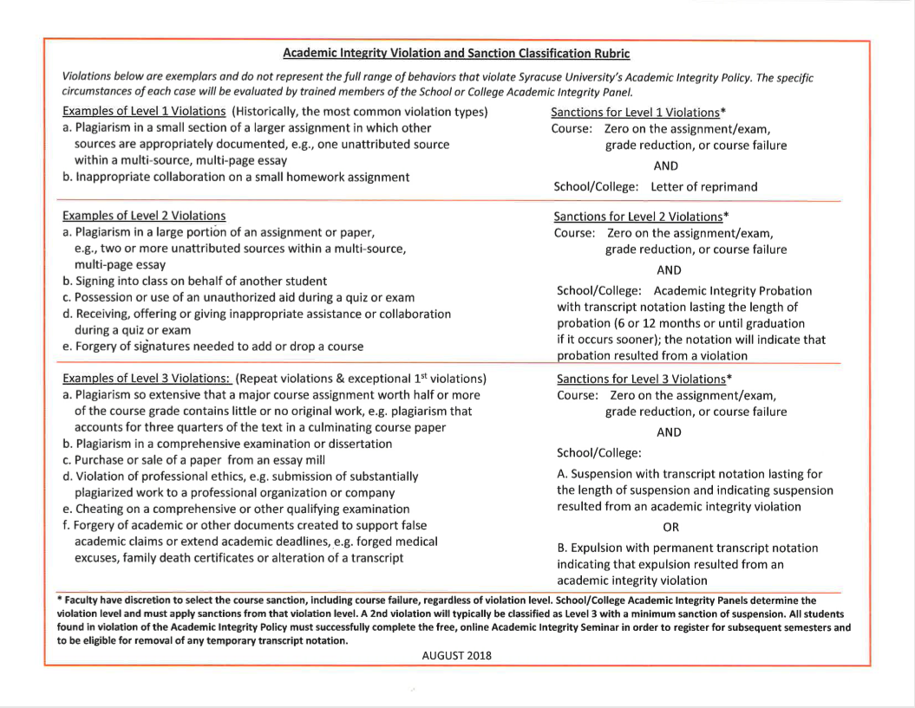
Academic Integrity Violation and Sanction Classification Rubric
GET TO KNOW THE CULTURE
USE RESEARCH-BASED STUDY STRATEGIES
UNDERSTAND & UPHOLD ACADEMIC INTEGRITY STANDARDS
Notes:
Academic Integrity Violation and Sanction Classification Rubric (August 2018)
Explain to students that there are three levels and provide a few examples from each level
Emphasize that these violation types are not negotiable with the exception of plagiarism (plagiarism can range from a Level 1 to a Level 3 violation depending on the amount that’s plagiarized and what assignment it is)
The violation types I would highlight are:
-Signing into class on behalf of another student = Level 2
-Possession OR use of unauthorized aid during an exam = Level 2
- Purchase or sale of a paper from an essay mill or other online location (e.g. Course Hero) = Level 3

Slide 29
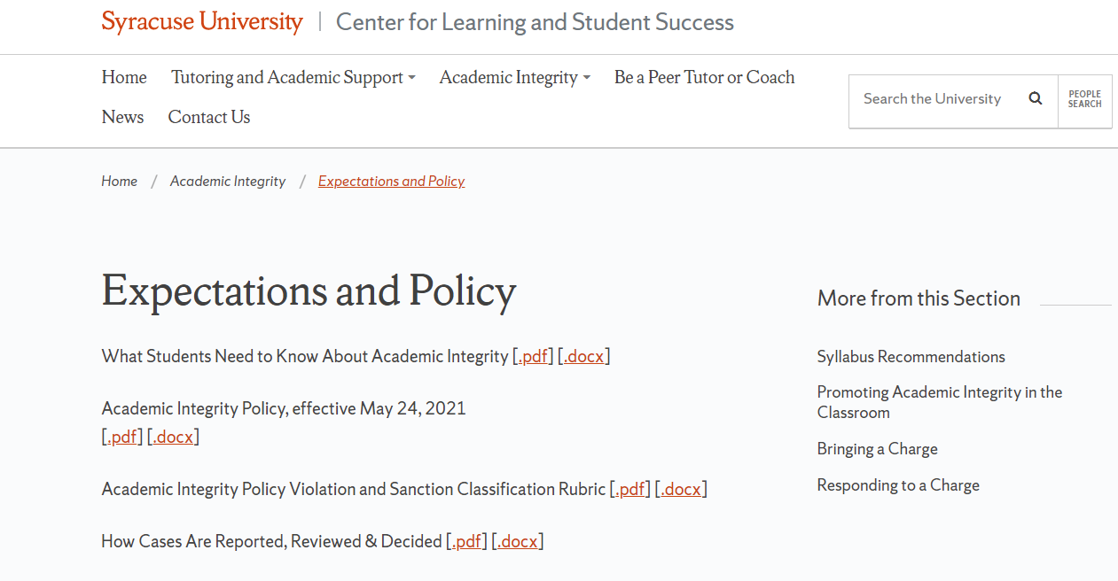
Academic Integrity Violation and Sanction Classification Rubric
GET TO KNOW THE CULTURE
USE RESEARCH-BASED STUDY STRATEGIES
UNDERSTAND & UPHOLD ACADEMIC INTEGRITY STANDARDS
http://class.syr.edu/academic-integrity/policy/
Notes:
Explain that students can find more information at class.syr.edu/academic-integrity

Slide 30

Questions?
LEARN THE CULTURE
RESEARCH-BASED STUDY STRATEGIES
ACADEMIC RESEARCH & INTEGRITY
Retrieved from https://app.pickit.com/#/market/featured-collections/photos/1/photo/10413524. Accessed 7/31/19.

Slide 31
CLASS: The Center for Learning and Student Success
Tutoring
Maximizing Your Learning
Mindfulness Workshops
Academic Coaching
Academic Integrity Education
CLASS@syr.edu
Notes:
For more information about academic integrity standards and academic support services, students are encouraged to go to email CLASS or visit our website: class.syr.edu.

